Slide 1
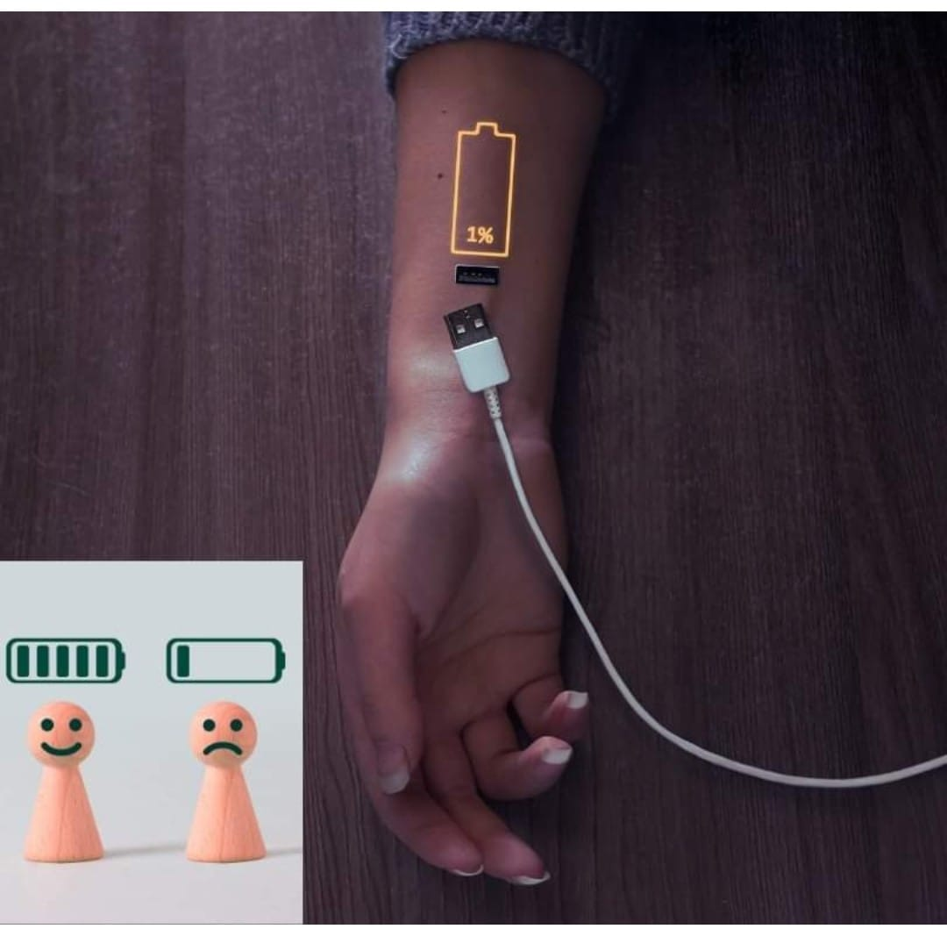
ARE YOU CHARGING? –Matt 14:23; Mark 1:35; Luke 5:16; Luke 4:17-21

Slide 2
Introduction
If Jesus Christ, our Lord and Saviour could find time to go and recharge His batteries, then I don’t know you excuse. I’m not talking about charging your phone, laptop or iPad. I’m talking about charging yourself. The same way you recharge your phone when the battery is low, you should constantly sustain a full charge to enable you function optimally.
Consciously or unconsciously, we find ourselves constantly giving out affection, energy, ideas, wisdom, counsels, attention, and several energy-draining emotions in our daily lives and as such, we must be sure to have a source to replenish the lost energy.

Slide 3
Reasons why people lose taste and relevance while still alive
Because they allowed themselves to be overdrawn without paying attention to recharge or replenish.
Association
Isolation
Too busy
Age is another reason why some lose relevancy.
Living in the past
Health –long term illness
Exposure to domestic violence or community

Slide 4
The Emphasis
You should not just have an output point in your life, you must also have an input point. From where do you draw power, wisdom, knowledge, grace, mentoring, strength, counsel, and inspiration? Do you just give out all these without having a replenishing structure in place? For as long as you are valuable, people will keep thronging you. Everyone will draw from you. But hey, don’t get it twisted, it’s not about you, it’s about the value or the gift you carry. Once they see that you are dry and empty, they’ll move on to the next valuable person.
To remain in charge, you must be charged.

Slide 5
HOW DO YOU STAY CHARGED?
Find your tribe where iron sharpens iron –Proverb 27:17
get a mentor, get a coach –Moses mentored Joshua
read good books to help your heart and refocus – Proverb 4;23
Take time to rest and to restore physical, spiritual, mental and emotional strength
attend webinars and conferences to sharpen your edge and keep it sharp.
Above all, read the scriptures. It’s quick, powerful and sharper that any two-edged sword! Psalm 119:11, 105

Slide 6
Conclusion
In these most trying times, we need know that stress do kill, and loads of what we occupy ourselves with are drain us spiritually and make us powerless Christian. However, if you can follow the factors outline earlier you will constantly stay charged. This is a secret of retaining mastery and relevance in life. Stay charged!

