Slide 1
NOVEMBER PUSH SUNDAY

Slide 2
Ecclesiastes 7:8
Act 20:24
Philippians 1:6
2 Chron 15:7

Slide 3
SETTLING ACCOUNTS
"O Lord, I shall not end this year with carry over. Help me to settle my account with Your divine favor and goodness".

Slide 4
REJECT NEGATIVITY
"I reject bitterness, self-condemnation and depression as this year ends in Jesus name".
“I reject bitterness, self-condemnation and depression as this year ends in Jesus' name “

Slide 5
FINISHING WELL
"I reject bitterness, self-condemnation and depression as this year ends in Jesus name".
"I declare that I shall finish this year well in Jesus name"

Slide 6
RESISTING A BAD ENDING
"I reject bitterness, self-condemnation and depression as this year ends in Jesus name".
"You demonic covenant of finishing badly. I resist you now in Jesus name".

Slide 7
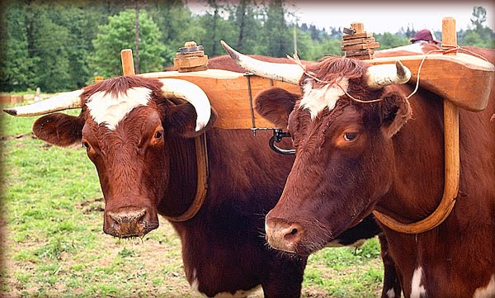
LIFTEN BURDENS
"I reject bitterness, self-condemnation and depression as this year ends in Jesus name".
"Let every burden be lifted and yoke destroyed. This year ends the way the Lord wants it to end for me".

Slide 8
ASKING FOR STRENGTH
"I reject bitterness, self-condemnation and depression as this year ends in Jesus name".
"Jesus, give me the strength and perseverance to finish the race you have set before me".

Slide 9
STAY FOCUSED
"I reject bitterness, self-condemnation and depression as this year ends in Jesus name".
"Help me to stay focused on you".

Slide 10
RENEWED PASSION
"I reject bitterness, self-condemnation and depression as this year ends in Jesus name".
"Renew my passion for serving you".

